Slide 1


Java-Based Smart
Procurement & Vendor Management System
Internship project by Dileep Kumar Yagati — a production-ready, secure, and auditable procurement platform built with Spring Boot, MySQL, JWT, and Maven.
SPRING BOOT
MYSQL JWT
By Dileep Kumar Yagati Infosys Springboard Virtual Internship 6.0 Batch 11-7

Slide 2

Problem Statement — Why we built this
Manual, paper-based requisitions and approval bottlenecks slow
procurement.
Limited real-time visibility causes delays and poor decision-making.
No centralized vendor master leads to inconsistent vendor data and risk.
Weak budget monitoring increases financial exposure and overspend.
Audits are time-consuming due to fragmented records and poor traceability.
These gaps create operational delays, compliance risks, and reduced accountability — prime targets for automation and modernization.

Slide 3
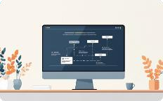



Proposed Solution — Core Concept
A centralized digital procurement platform that automates the requisition-to-PO lifecycle while providing transparency, controls, and auditability.
End-to-end Automation
Automates Requisition → Approval → PO creation with configurable rules and notifications.
Real-time Tracking
Live status updates and dashboards for requisitions, POs, and deliveries.
Centralized Vendor Management
Single source of truth for vendor data, contracts, and performance metrics.
Secure, Role- Based Access
JWT-based authentication with role and permission enforcement for least-privilege access.

Slide 4
Technology Stack
Backend
Spring Boot 3.2.5 (Java 17/21) — RESTful services, dependency injection, and actuator.
Database
MySQL 8.0 — normalized relational schema, foreign key constraints, indexed queries.
Security
Spring Security + JWT, BCrypt password hashing, CORS, and global exception handling.
Reporting & Docs
Swagger (OpenAPI) for API docs; JasperReports & Apache POI for PDF/XLSX exports.
Build & CI
Maven for builds and dependency management; suitable for CI pipelines.

Slide 5
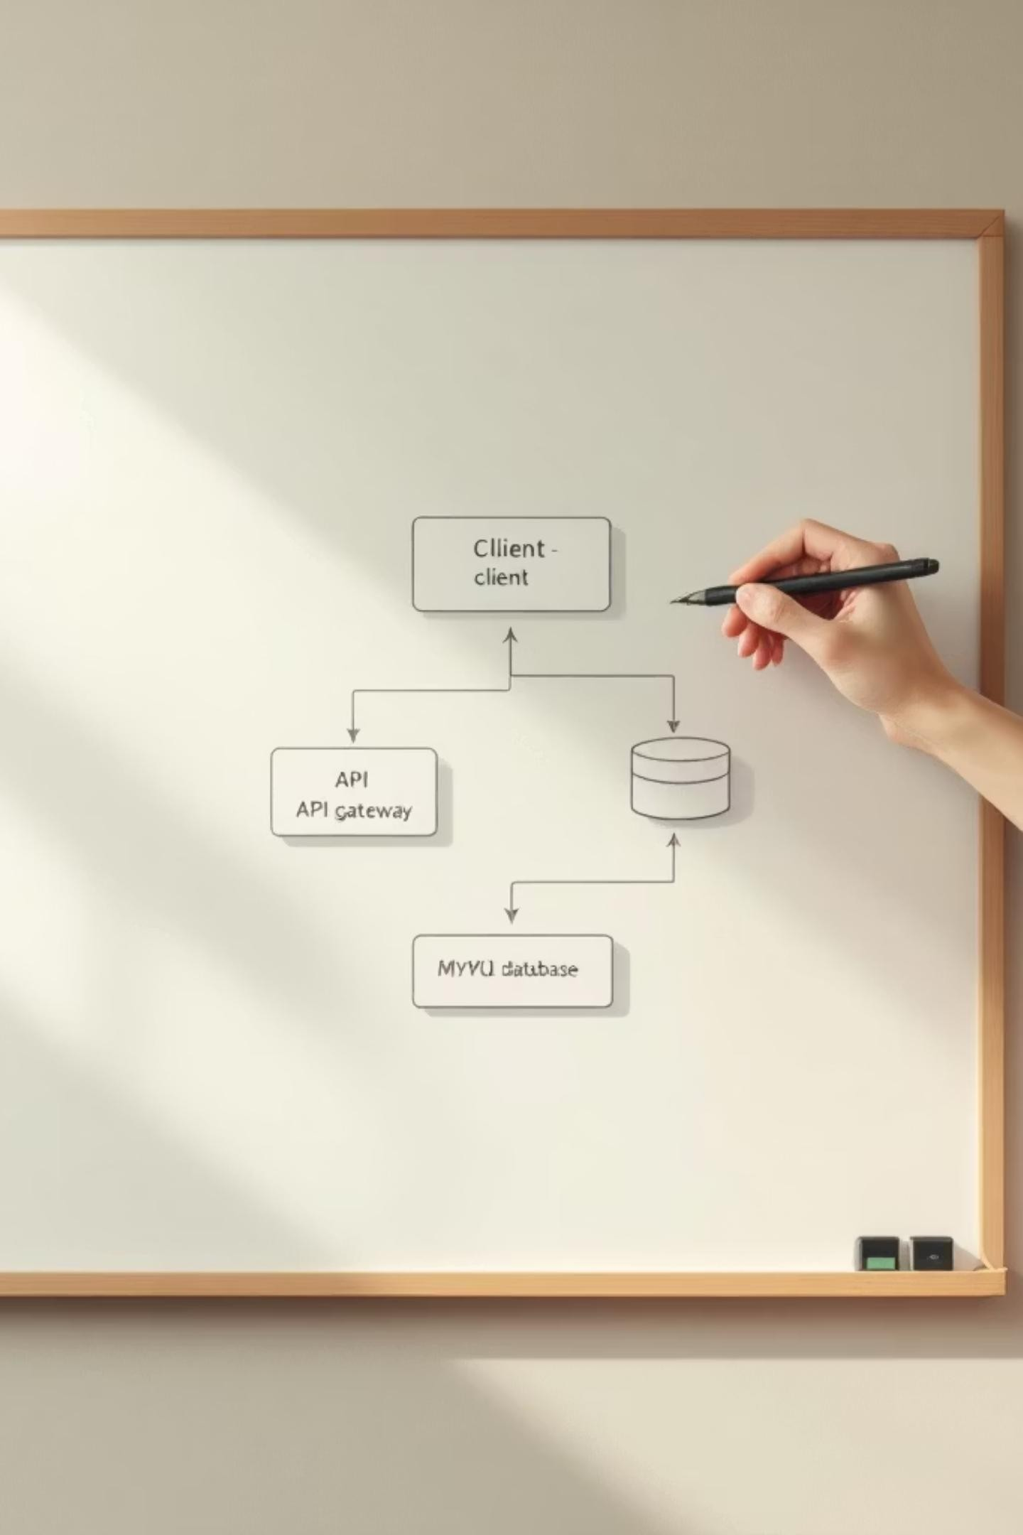
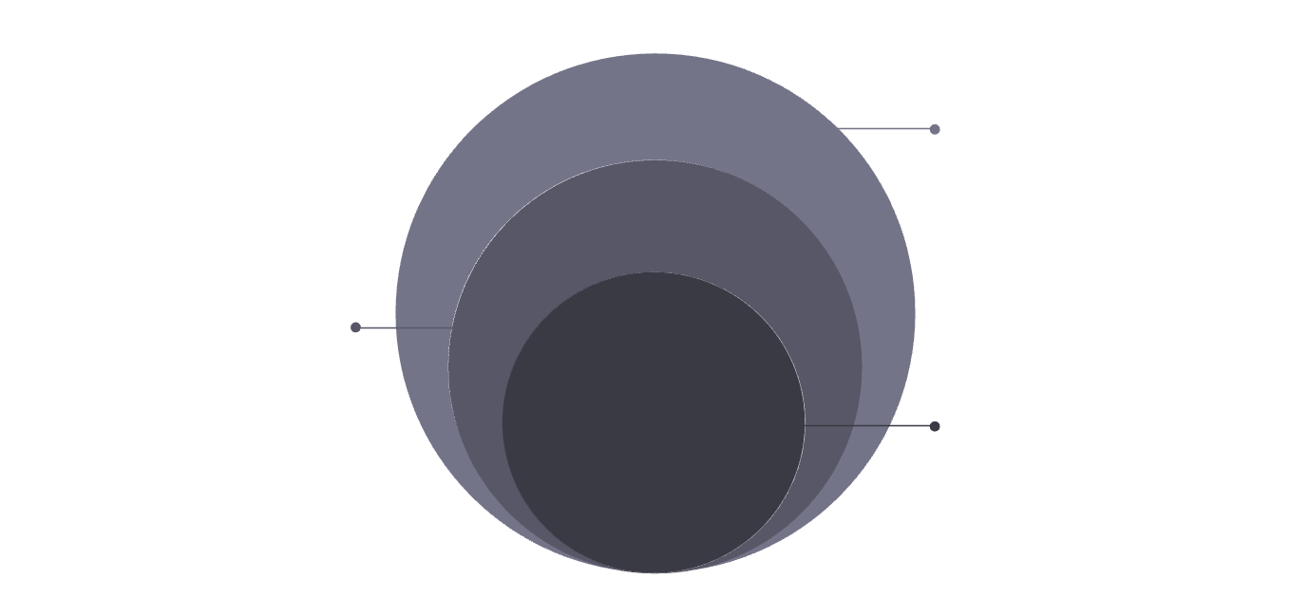
Project Architecture — Layered Design
Scalability
Stateless REST APIs enable horizontal scaling behind load balancers.
Repository & Data
Data access, MySQL, external
vendors
Maintainability
Layered codebase supports unit and integration testing, and clean CI workflows.
Service
Business rules and
orchestration
Controller
Stateless REST API endpoints
Extensibility
Modular modules for vendor management, reporting, and auditing simplify feature additions.
Diagram illustrates separation of concerns: Controllers (API), Services (business rules), Repositories (data access), making the system modular and testable.

Slide 6




Database Design — Key Entities
Normalized relational schema with enforced referential integrity and indexes for performance.
Users & Roles
Authentication, role assignments (Admin, Manager, Employee), and audit metadata.
Vendors
Vendor master with contact info, contracts, ratings, and compliance documents.
Requisitions
Line-item details, cost centers, budget references, and current status.
Purchase Orders & Approvals
PO creation, vendor linkage, approval history, and closure records for audits.

Slide 7
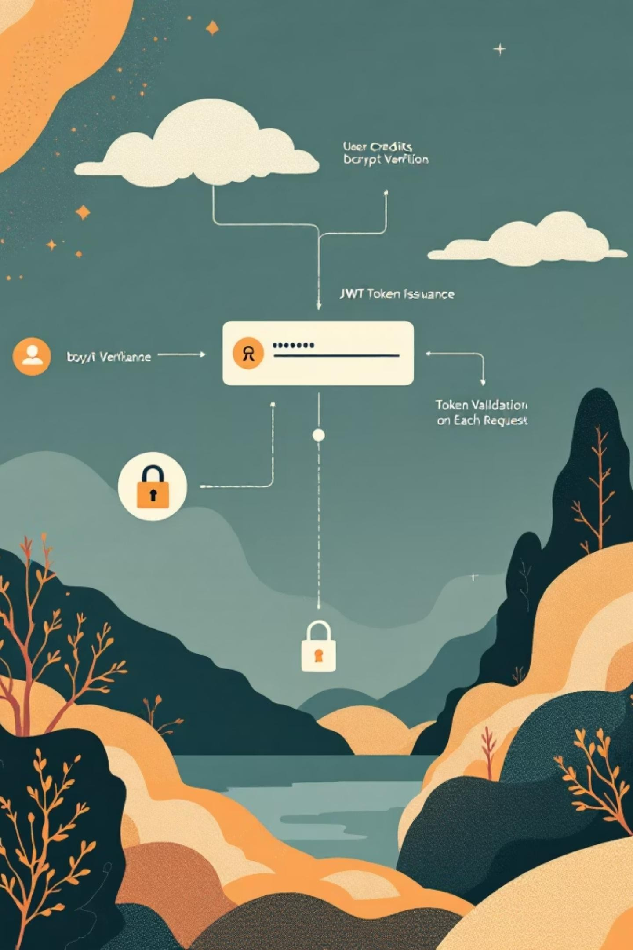

Authentication & Security
Robust authentication pipeline and defensive controls to protect procurement data and enforce least
privilege.
1. Credential Verification
Passwords hashed with BCrypt; account lockout and password policies enforced.
JWT Issuance
Signed JWT tokens include role claims; short-lived tokens with refresh flows possible.
Request Validation
JWT filter validates tokens per request; role-based authorization on endpoints.
4. Defensive Practices
CORS configuration, input validation, parameterized queries, and global exception handling.

Slide 8
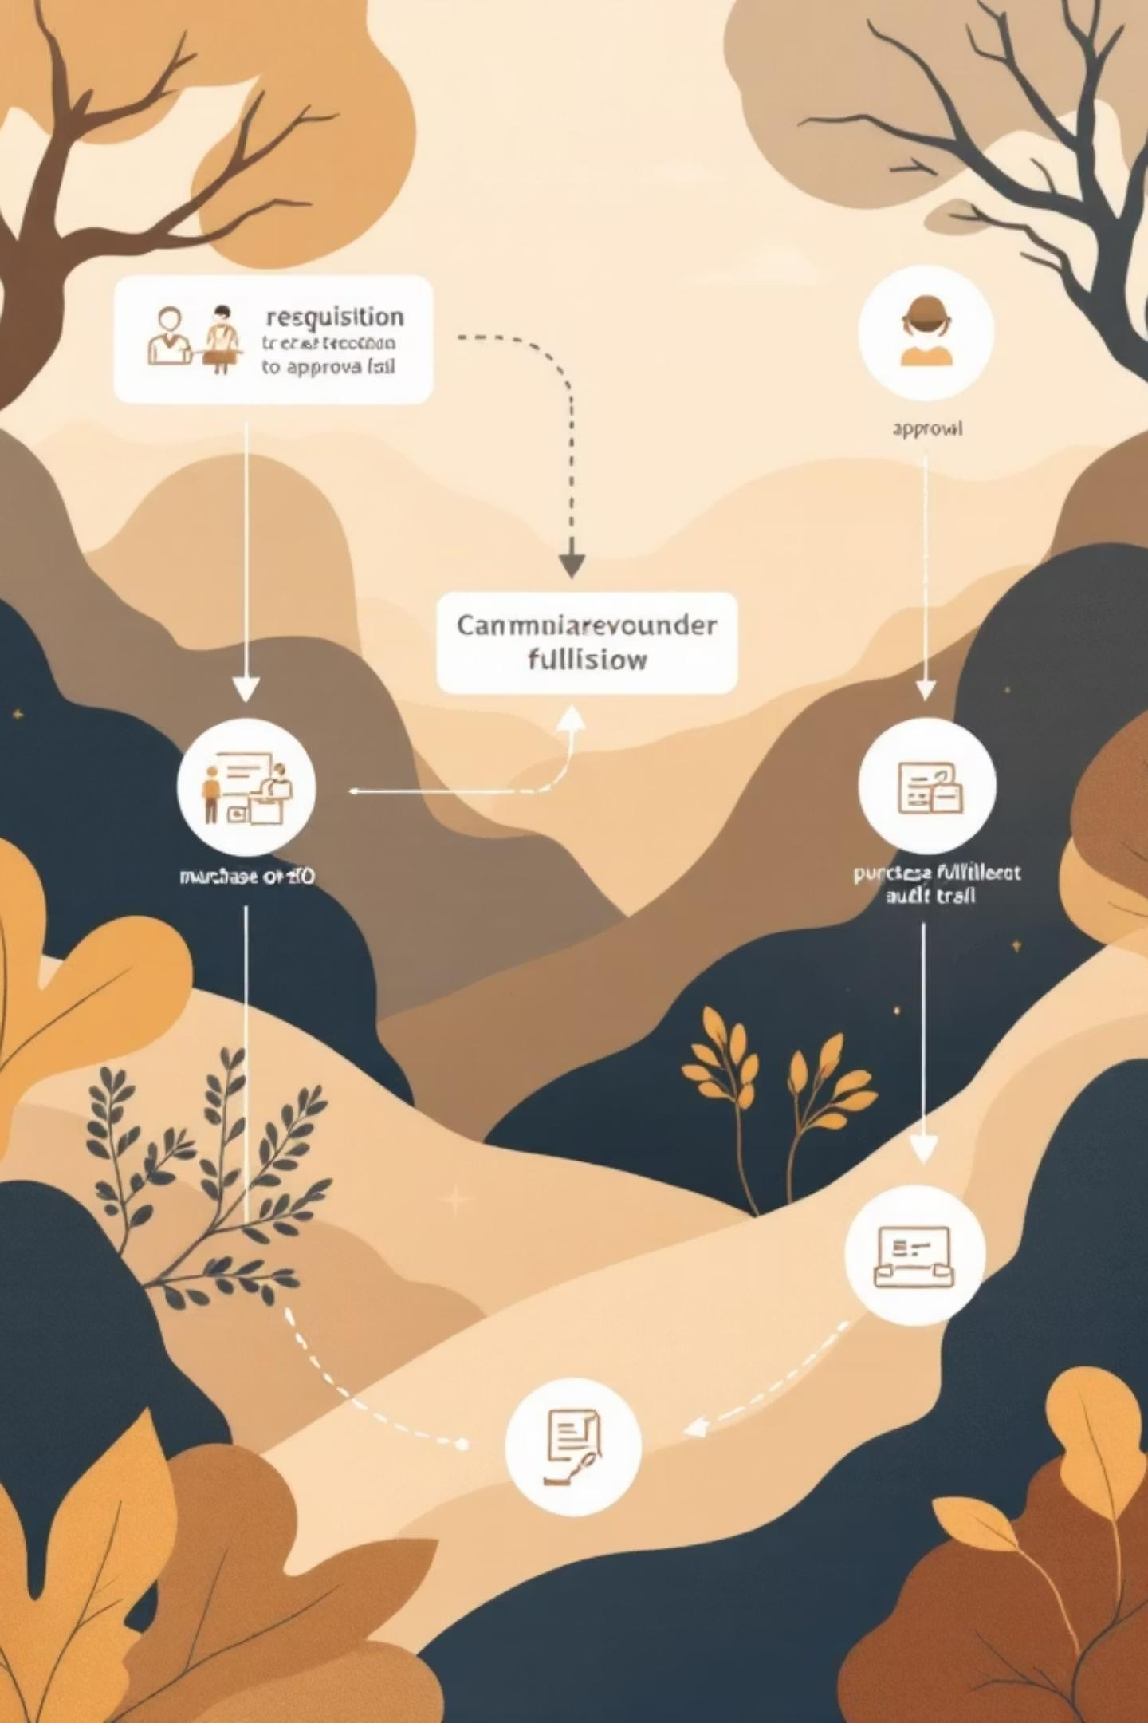
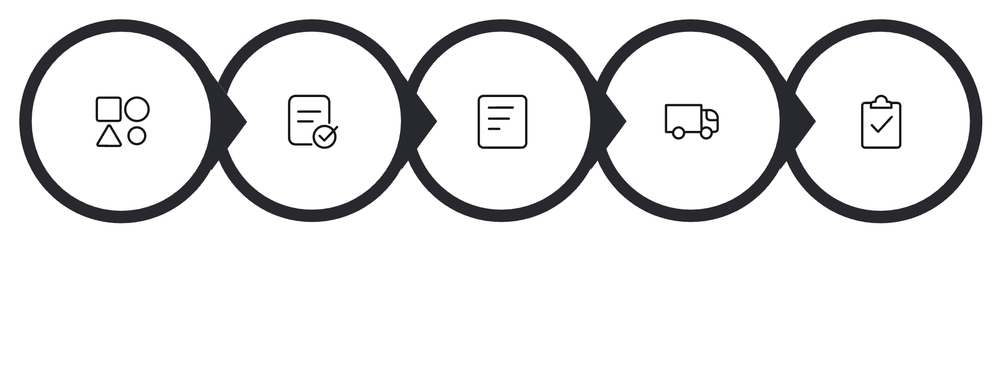


Procurement Workflow — From Requisition to Closure
Requisition
Manager
Approval
Purchase
Order
Vendor
Assigned
Fulfill & Audit
The system journals each event for a complete audit trail; configurable approval chains and budget checks prevent overspend before PO issuance.

Slide 9


Requisition Lifecycle — Status Model
CREATED
Draft created by employee — editable until submission.
SUBMITTED
Sent to approvers; system enforces required fields and budget validations.
APPROVED
Manager/s authorized; ready for PO conversion and vendor assignment.
REJECTED
Returned with comments for correction; versioned to preserve history.
CLOSED
Linked to finalized PO and fulfillment records — immutable for audit.

Slide 10
Key Features & Deliverables
Automated Workflow
Configurable approvals, notifications, and PO conversion from approved requisitions.
Reporting & Export
Dynamic PDF/XLSX generation via JasperReports and Apache POI for financial and audit reports.
Audit Trail
Immutable event logging for approvals, edits, and PO lifecycle to support compliance.
Financial Controls
Automated tax calculations, budget checks, and spend validations before approvals.
Role-Based Dashboards
Admin, Manager, and Employee views with tailored KPIs and action lists.
High-Performance APIs
Optimized endpoints with pagination, indexing, and sensible caching for large datasets.
Next steps: demo environment, integration with ERP/payables, and automated test coverage to prepare for production handoff.

Slide 11

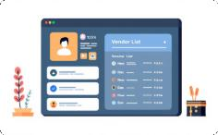

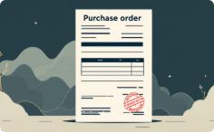

API Structure
Modular, RESTful APIs organized by functional areas for predictable integration and easy maintenance. Clear URI patterns support role-based access and versioning readiness.
Authentication APIs
/auth/login — session token issuance
/auth/register —
onboarding new users
Vendor APIs
/vendor/create —
register vendor
/vendor/all — list vendors
/vendor/{id3 — vendor
details
Requisition APIs
/procurement/requisiti on/create — submit request
/procurement/requisiti on/all — query requests
Purchase Order APIs
/procurement/purchas e-order/create — issue PO
/procurement/purchas e-order/all — list POs
Report APIs
/reports/vendor?forma t=pdf — PDF export
/reports/vendor?forma
t=excel — Excel export

Slide 12
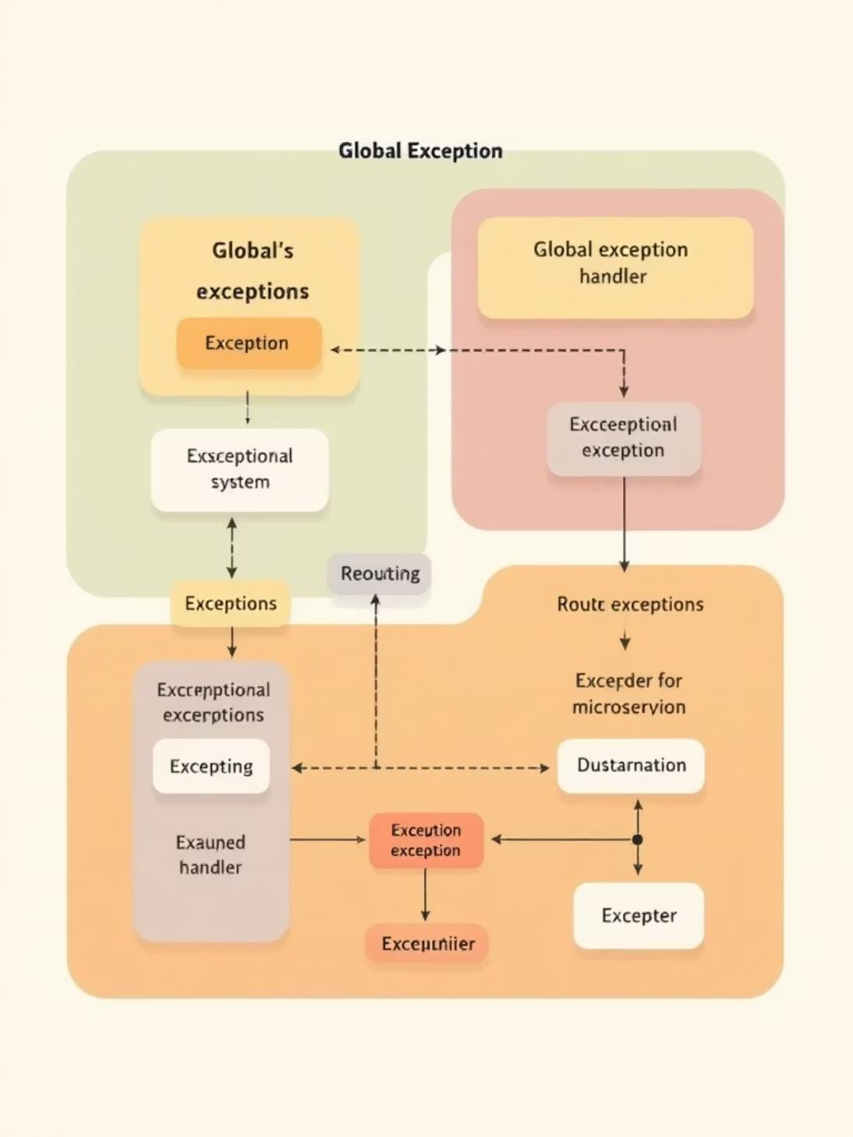
Error Handling Strategy
Consistent, structured error responses improve reliability and speed up troubleshooting. Handled centrally with a clear contract for consumers.
GlobalExceptionHan dler
Centralizes exception mapping to standardized HTTP responses.
Custom Exceptions
Standard Response Body
Timestamp · Status Code
· Error Message · Request Path — consistent for logging and client parsing.
BusinessException — domain rule violations
ResourceNotFoundE xception — 404 semantics
UnauthorizedExcepti on — authentication/author ization failures

Slide 13

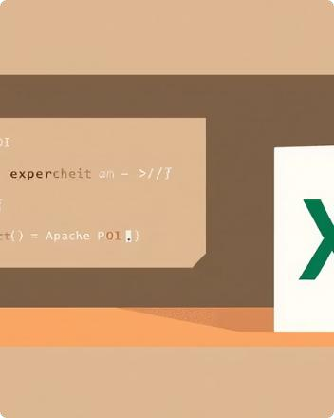
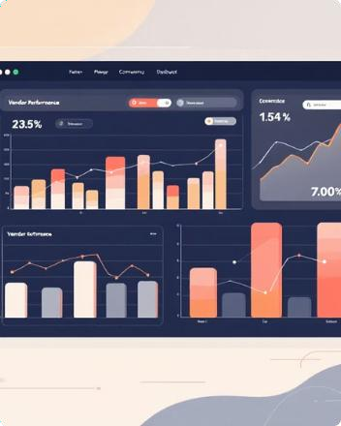
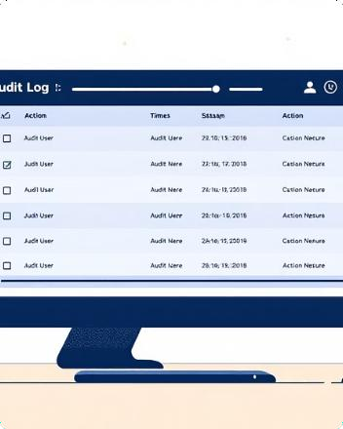
Reporting & Audit Features
Robust exports and comprehensive audit trails enable compliance, manager oversight, and performance tracking.
PDF Reports
Dynamic PDF generation via JasperReports for printable, templated vendor and PO reports.
Excel Export
Apache POI-based Excel exports for analysis, filters, and downstream processing.
Performance & Summaries
Vendor performance reports and purchase order summaries for procurement insights.
Approval & Audit Trails
Approval history and manager-level audit logs preserve decision context and support compliance reviews.

Slide 14
System Limitations
Transparent constraints for realistic deployment planning. These are prioritized for future releases.
No payment gateway
integration
Payments are out-of- scope; external payment provider integration required for end-to-end procurement finance workflows.
No vendor self-login
Vendors lack a dedicated portal — limits supplier- driven updates and self- service.
No native mobile
apps
Mobile access via responsive web only; offline and native push workflows are unavailable.
Single DB instance
No sharding or multi-db partitioning — potential scalability and availability constraints for very large enterprises.
No external ERP integration
Financial and inventory sync require connectors for ERP systems (e.g., SAP, Oracle).

Slide 15
Future Enhancements
Roadmap items to elevate the platform to enterprise-grade capabilities — focused on automation, scalability, and supplier empowerment.
AI Spend Analytics
Predictive models for spend forecasting, anomaly detection, and supplier recommendations.
Supplier Self-Service
Vendor portal for profile management, invoices, and status updates — reduces admin load.
Native Mobile Apps
Android/iOS apps for approvals, push notifications, and on-the-go requisitions.
Immutable Audit Logs
Blockchain-backed ledger for tamper- evident audit trails and stronger compliance evidence.
Multi-DB Scalability
Sharding and read-replicas for high- volume throughput and improved fault tolerance.

Slide 16

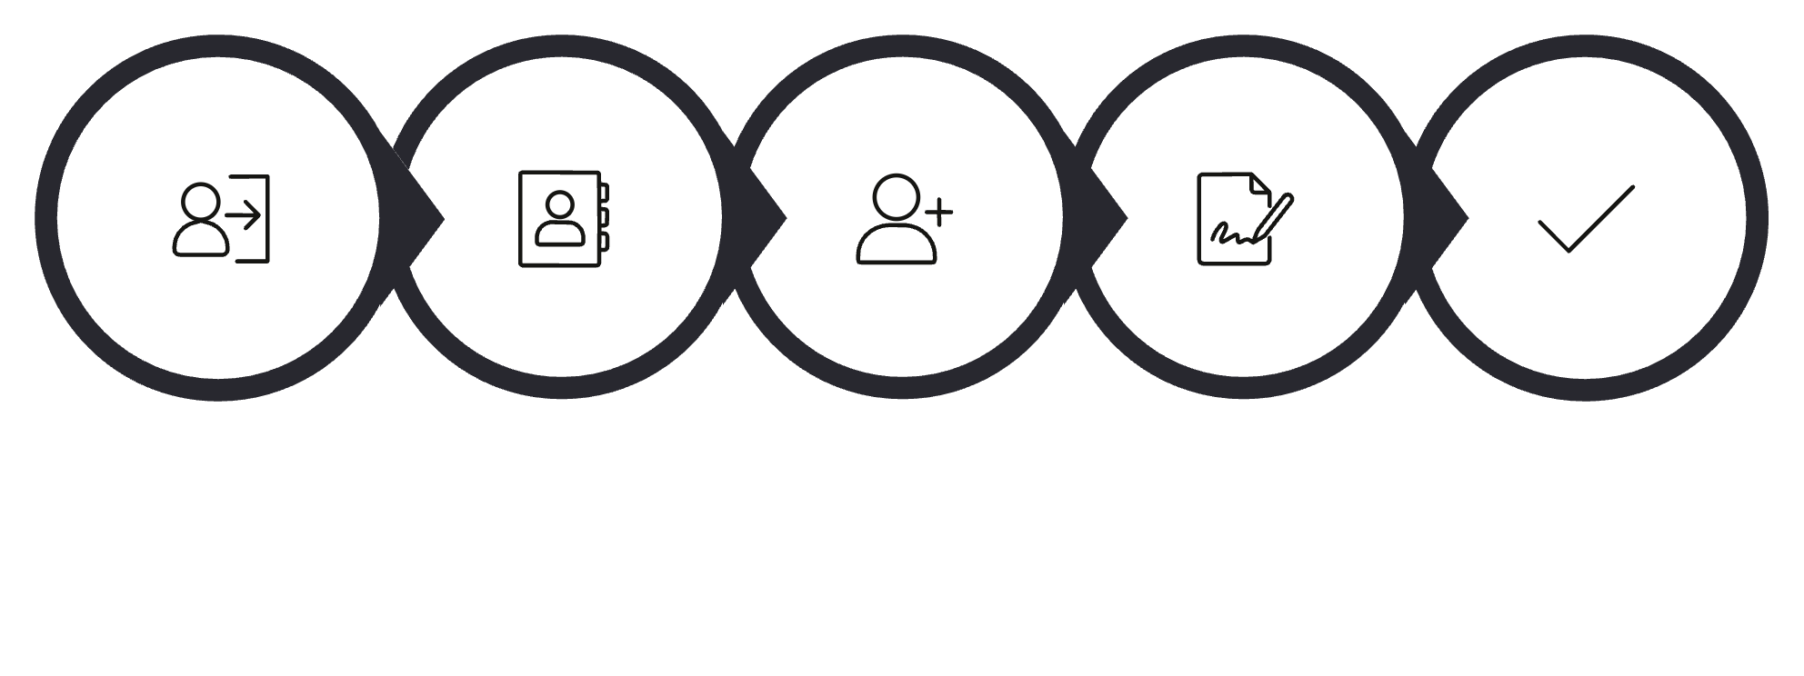


Demo Outline
Planned live flow to showcase core capabilities end-to-end. Keep demo focused and timeboxed to highlight value.
Login Admin
Vendor Registry
Create Vendor
Create & Submit
Approve Manager
Follow this sequence to demonstrate authentication, CRUD operations, approval workflow, PO conversion, and reporting exports.

Slide 17

Conclusion
Digitization & Efficiency
Replaces paper processes with auditable, role-based workflows that reduce cycle
time.
Security & Access Control
Token-based auth and role enforcement protect sensitive procurement actions and data.
Reporting & Compliance
Exportable reports and detailed audit logs support governance and financial reconciliation.
Scalable Architecture
Designed for modular growth; roadmap addresses enterprise needs like scaling and integrations.
The system delivers a pragmatic, secure foundation for modern procurement with clear upgrade paths for enterprise adoption.

Slide 18
Thank You
Questions & Discussion
Next Steps
Contact
Product Owner · Technical Lead · Procurement PM — available for follow-ups and technical sessions.
Schedule deep-dive on integrations (ERP, payment providers)
Prioritize roadmap items with stakeholders
Plan pilot with representative vendor
group

